Slide 1
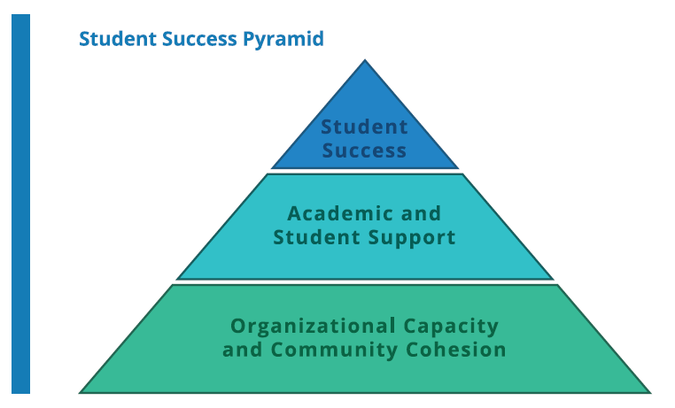
Strategic Implementation Plan Tracking Project Proposal
5/12/2021

Slide 2
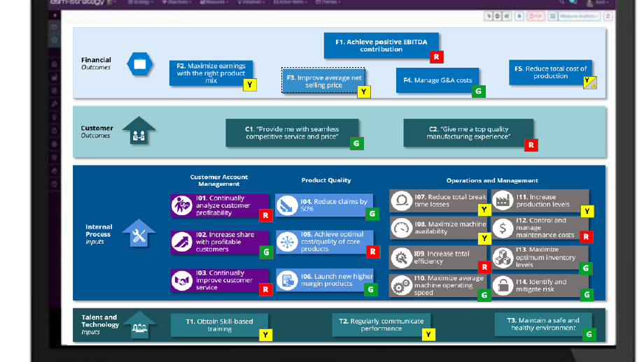
ESM software
ESM is based on Balanced Scorecard

Slide 3
Overall Approach
ESM provide software and consulting support with 15 to 20 virtual education, training, and workshop sessions, and will include all pre- and post- material preparations. The consulting includes
reviewing strategy input documents
Executive interviews: up to 8 leadership and management team interviews
draft a straw model strategy map review with “core team”
working with the core team to identify, inventory, and preliminarily map measures to strategic objectives
The core team will identify initiatives that will feed into a workshop prioritization and mapping exercise with the leadership team.
Up and running for reoccurring strategy review.

Slide 4
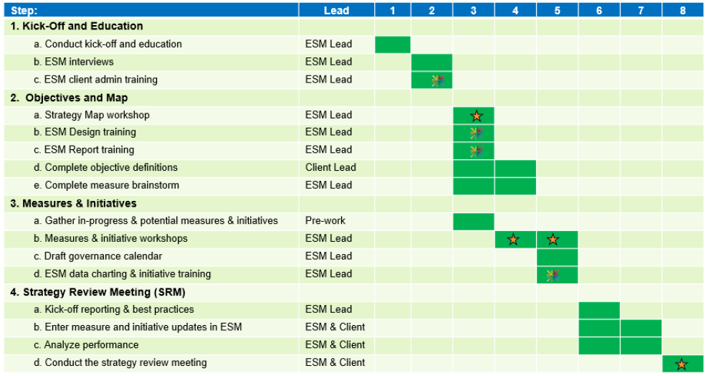
Timeline (assume D day is the college day 8/20)
7/2
7/9
7/16
7/23
8/6
8/20

Slide 5
Cost
Item | Cost
8 weeks facilitation fees for ESM FastTrack (one-time fee) | $40,000
ESM software configuration and training fee (one-time fee) | $1,800
Single Sign-On connection fee (one-time fee) | $6,000
ESM Strategy software fee for one Contra Costa College “enterprise” license, unlimited users. | $10,560
80 user licenses to ESM OKR (Objective Key Results) software | $3,075
1st Year $61,435 and $13,635 annually afterwards
Notes:
Single sign-on (SSO) is an authentication scheme that allows a user to log in with a single ID and password to any of several related, yet independent, software systems.
ESM+Strategy empowers teams to formulate, track, implement, and communicate their strategy leveraging the Balanced Scorecard framework.
ESM+OKR focuses on the Objective Key Results methodology to help organization tactically get work done, whether strategic or operational. EMS+Strategy links to ESM+OKR to ensure incorporated Agile based project management.

Slide 6
Backup Slides

Slide 7
Step 1: Document Review
CCC: provide current organizational information, including existing strategy documents
ESM: plan the future job
ESM Facilitation lead:Mario Bognanno

Slide 8
Step 2: Executive interviews
CCC: provide a list of leadership and management team for interviews to ensure a diversity of input related to our SP.
ESM: conduct the interview and create a draft strategy map

Slide 9
Step 3: Review Draft Strategy Map
CCC: form a core team to review the draft strategy provided by ESM.
ESM: Confirm strategy goals, overall architecture of the strategy map
Q: How many people should be selected to the core team and how to recruit them?
Responsibilities of Core Team

Slide 10
Step 4: map measures to strategic objectives
CCC: core team works with ESM to identify measures and existing data base to support objectives.
ESM: help core team to identify measures, ways to calculate, manage and generate measures.
Q: Will the system be able to migrate our existing database automatically? Do we need to hire a data entry personnel? Can we have the IT department to help on migrating the existing data?

Slide 11
Step 5: Identify and prioritize initiatives
CCC: The core team will identify initiatives that will feed into a workshop prioritization and mapping exercise with the leadership team.
ESM: help core team to identify initiatives and provide training on managing and reporting on initiatives, milestones, and tasks.

Slide 12
Step 6: Up and running for reoccurring review
CCC: core team works with ESM to identify measures and existing data base to support objectives.
ESM: help populate the strategy in ESM and guide CCC to prepare the first review meeting.

